Slide 1

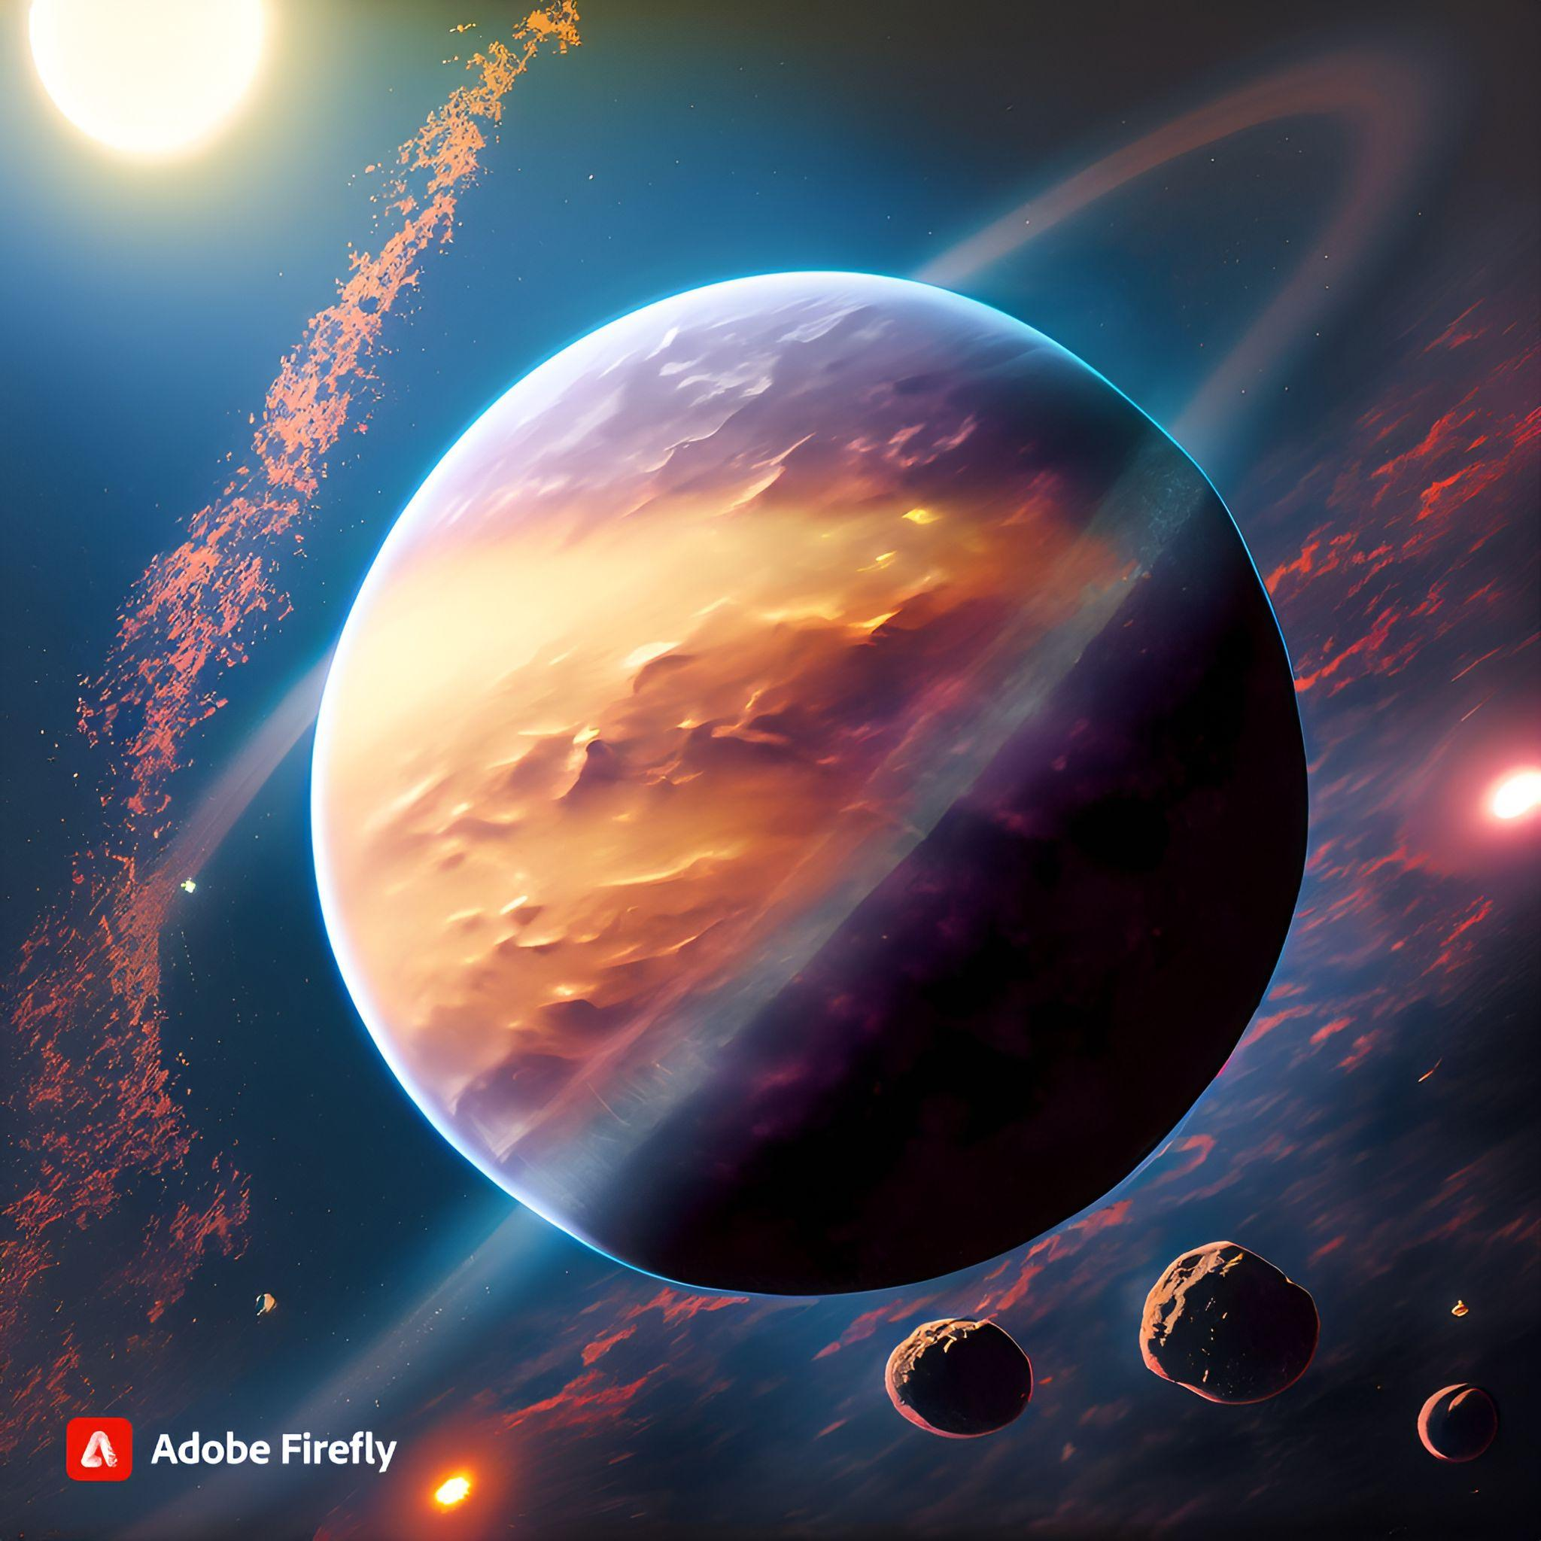

HABITABLE EXOPLANET
Creating Worlds Beyond Our Own
Presented by UFOs
08 October 2023
Notes:
Hnaya anhdro 3la challenge

Slide 2
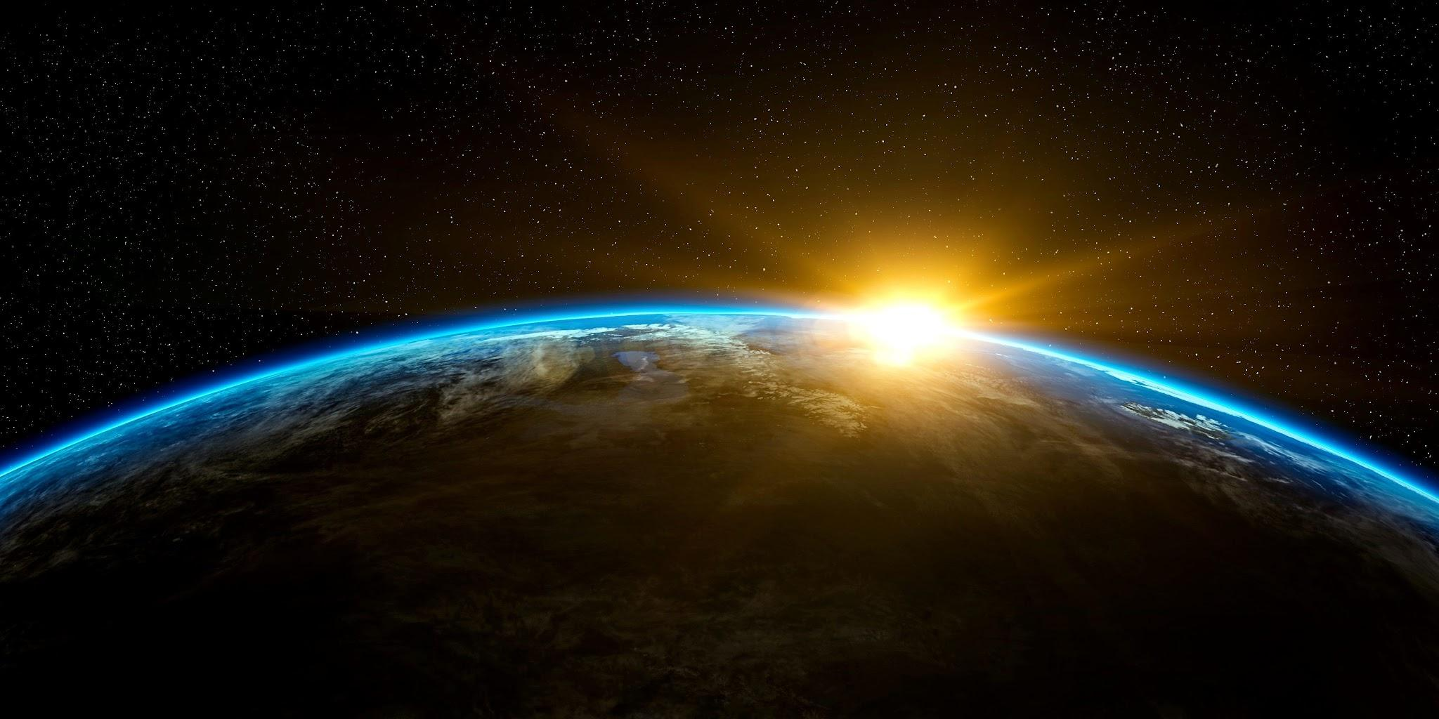
01
CHALLENGE
Habitable Exoplanet: Creating Worlds Beyond Our Own

Slide 3
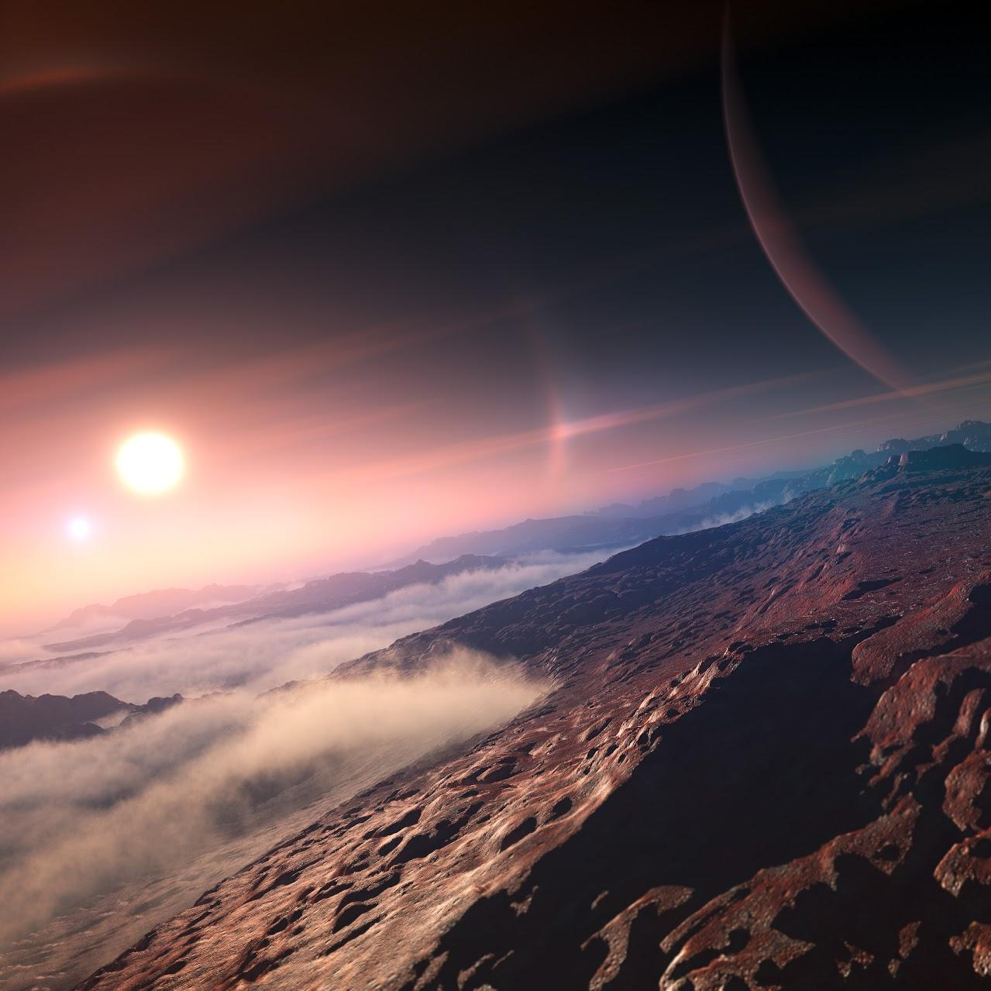

SOLUTIONS
Myriabel.co: Exploring Planetary Data with AI Chatbot Brilliance.
Offering insightful answers and engaging conversations about the mysteries of the Myriabel planet
Myriabel: An Habitable World Beyond Earth. Or not?
Discover Myriabel, an extraordinary exoplanet, with unique features and a thriving discoveries.

Slide 4
02
Myriabel
A habitable planet

Slide 5
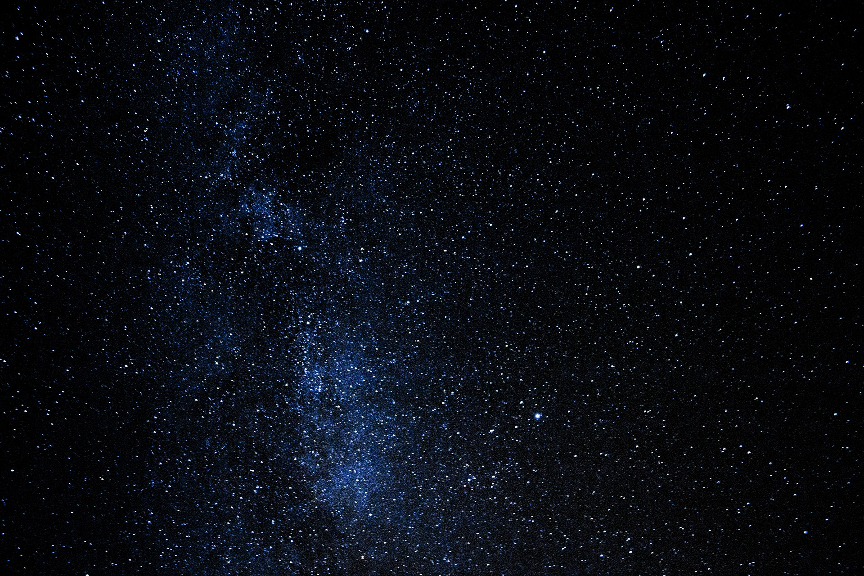
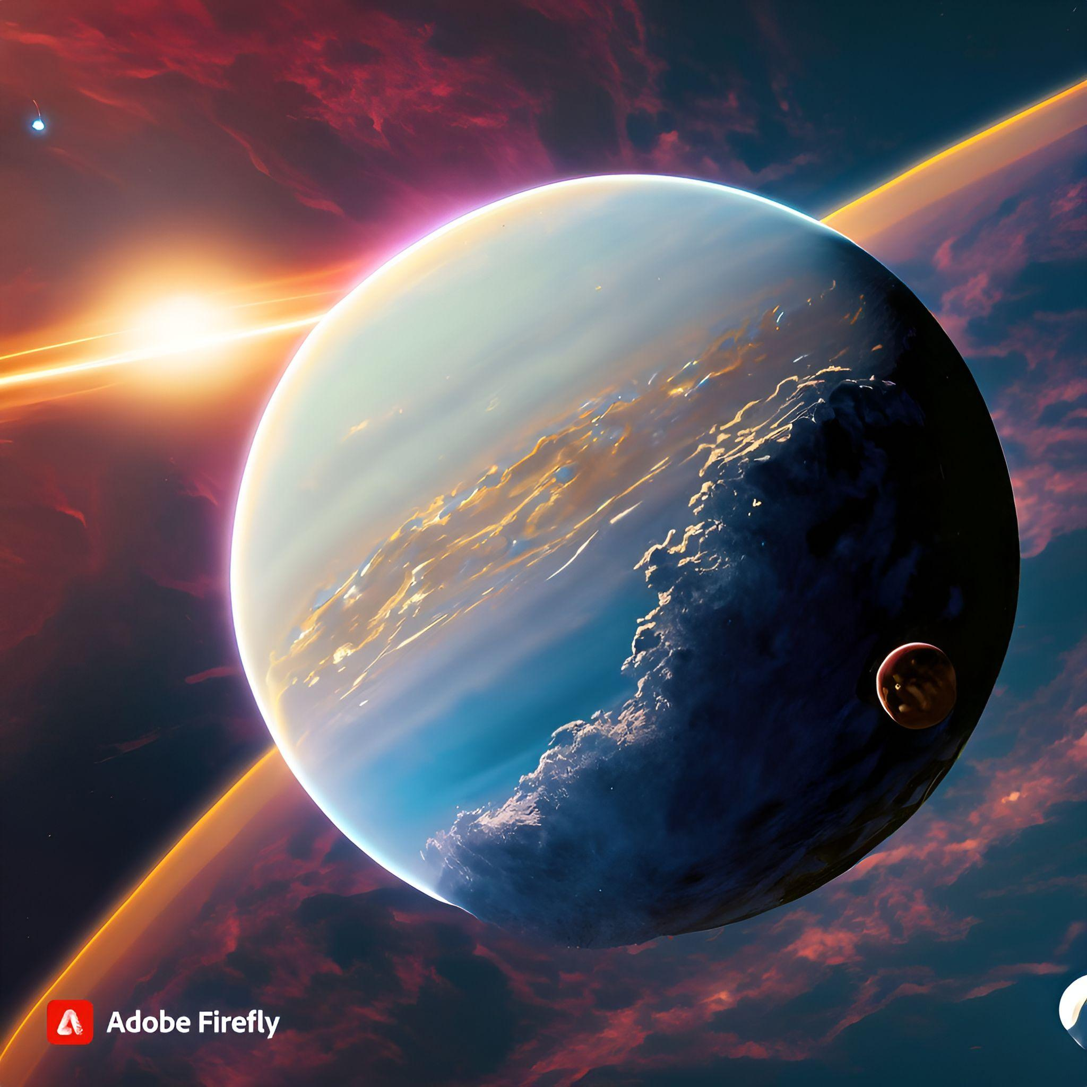
Our Exoplanet: Myriabel
Orbits a G-type main-sequence star.
It is approximately 1.2 times the size of Earth (1.2 Earth radii).
Has a surface gravity about 10% stronger than Earth's
Is situated within the habitable zone of its parent star.

Slide 6
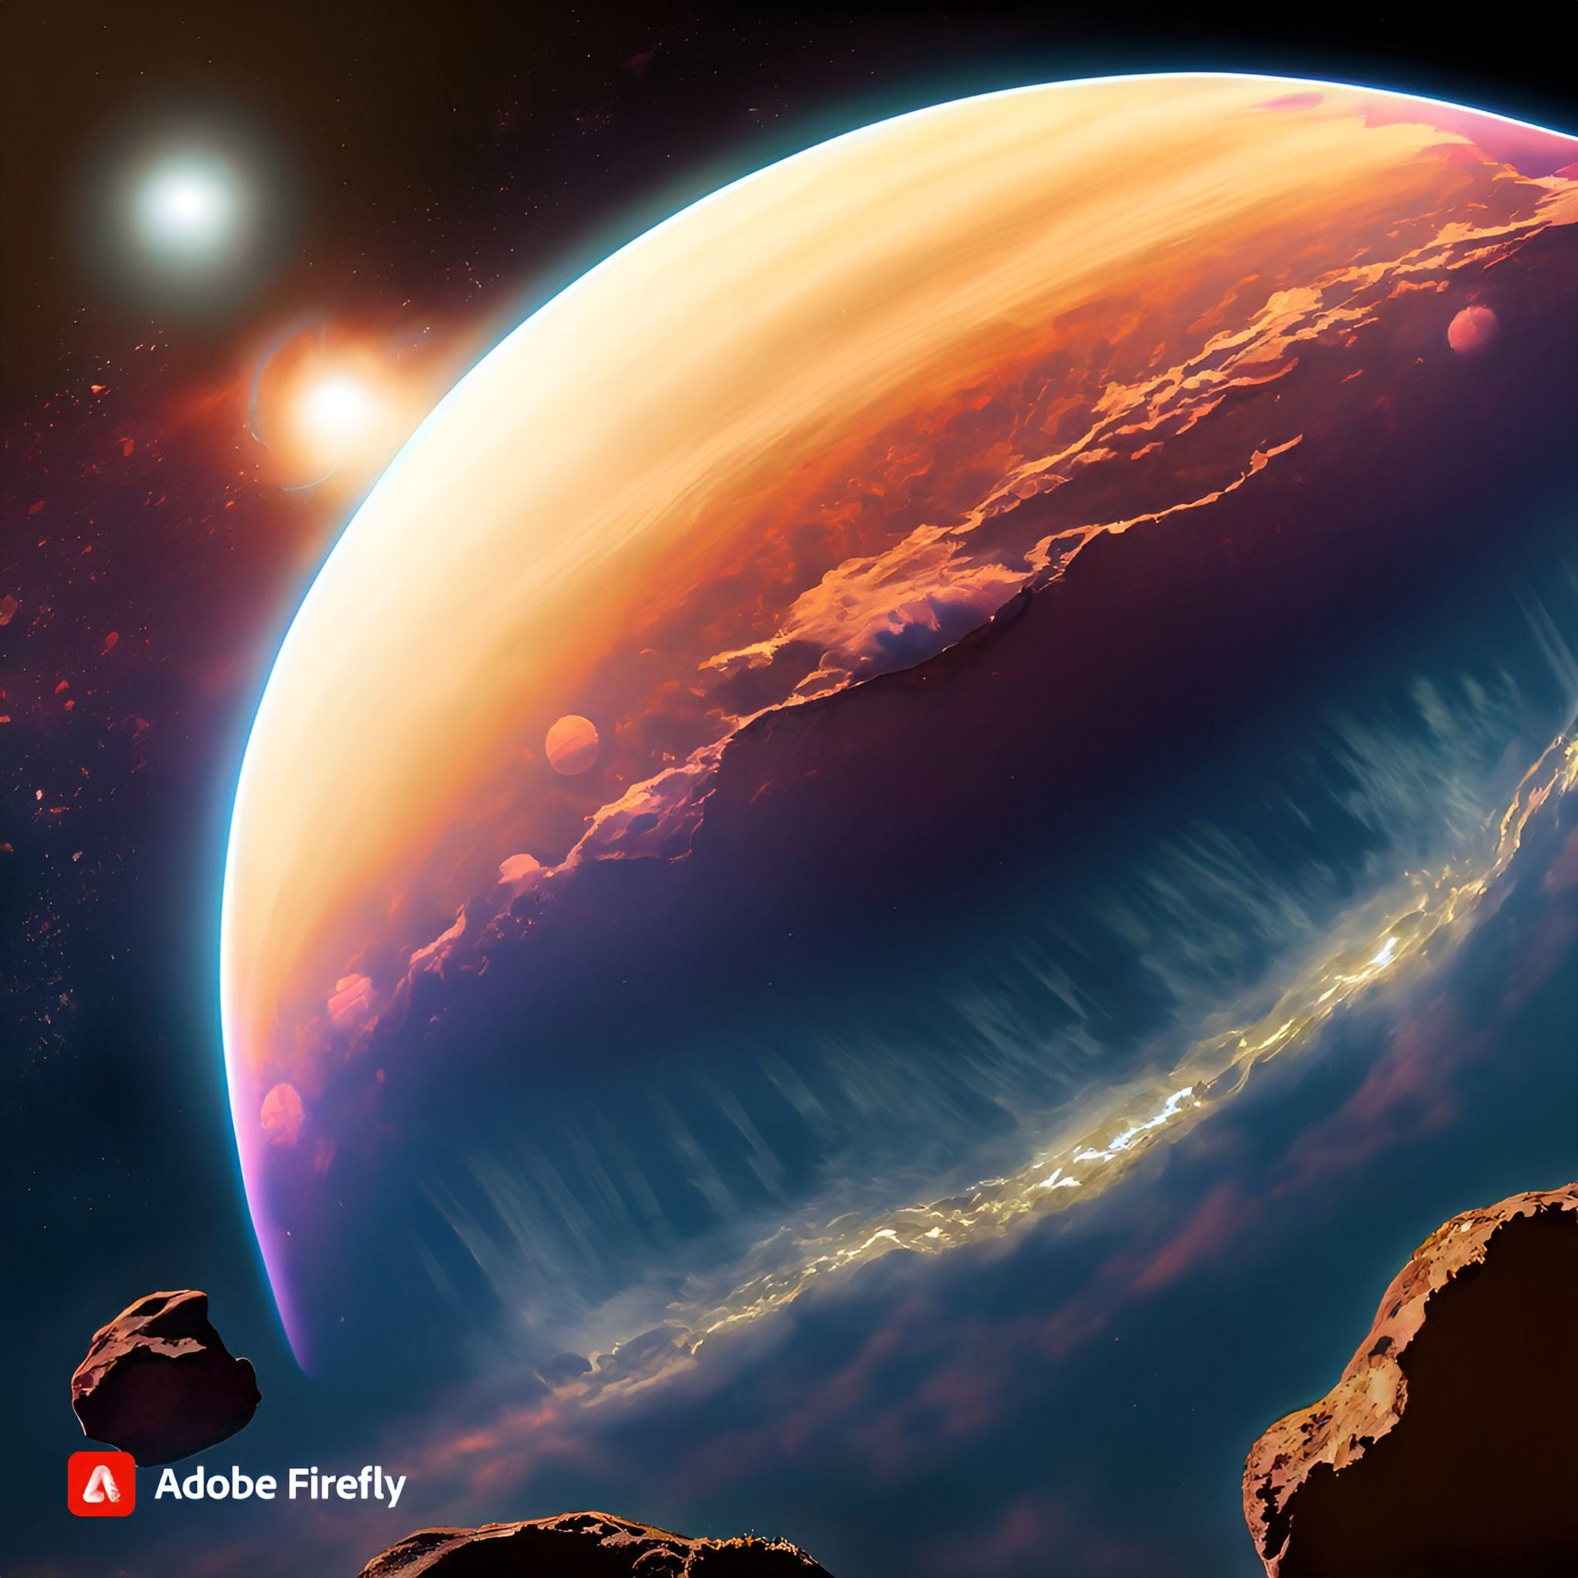
Our Exoplanet: Myriabel
Liquid water can be found on its surface.
The planet's atmosphere consists of 60% nitrogen, 33% oxygen, and other gases, including carbon dioxide and water vapor.
The elevated oxygen levels support advanced life forms.

Slide 7
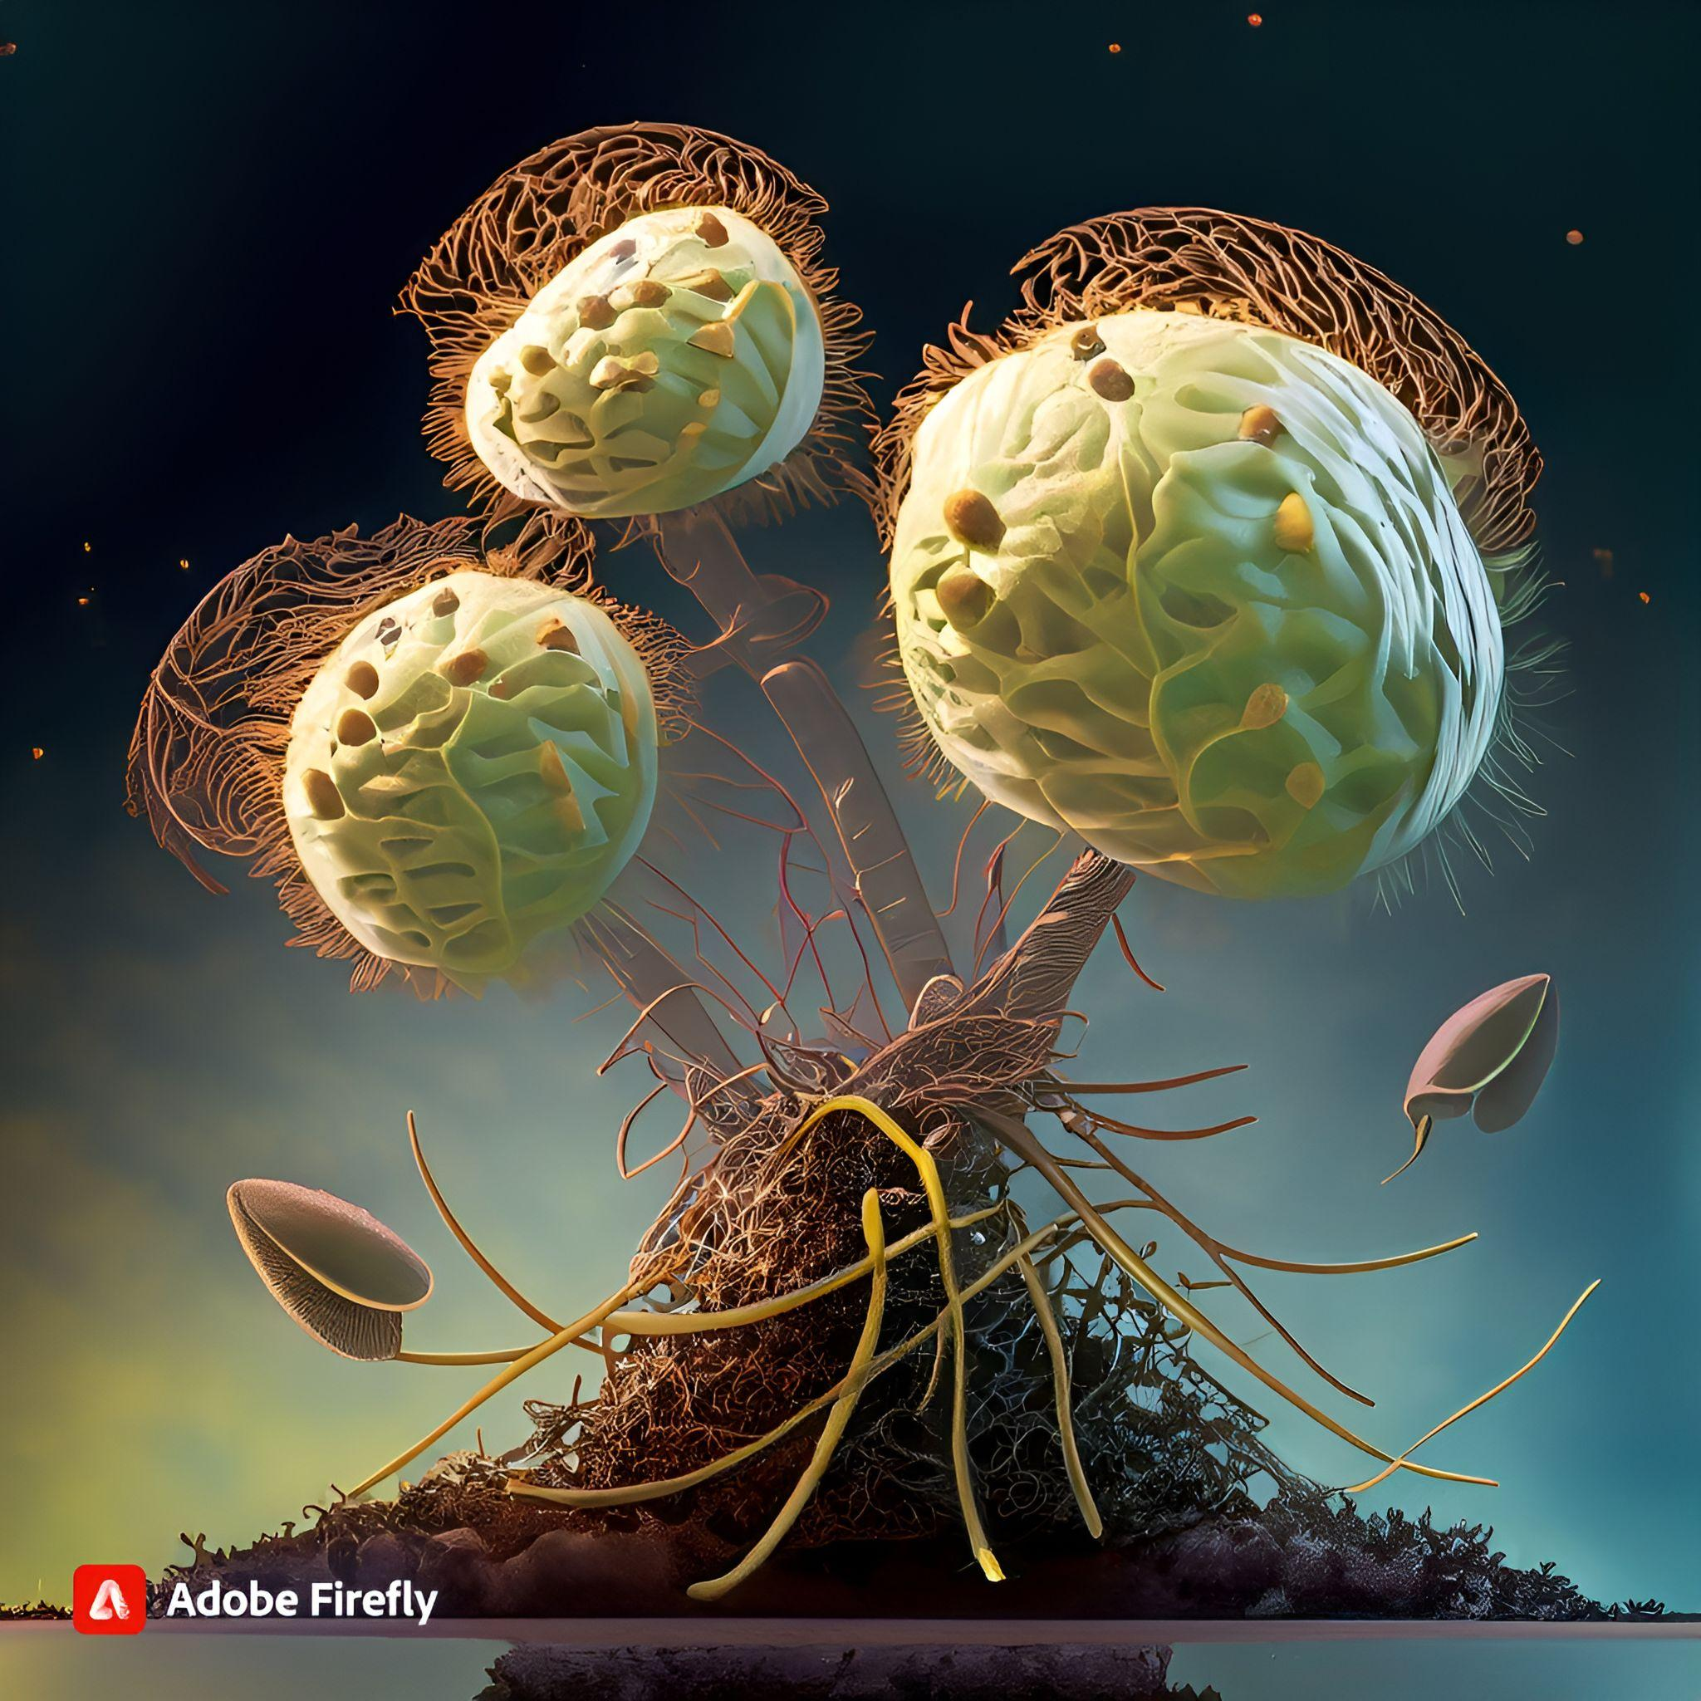
Potential Life Forms and their Adaptations
Aerophytos (Air-Borne Plants)
Gigantomachians (Large Reptilian Creatures)
Microbial Sky Gardens

Slide 8
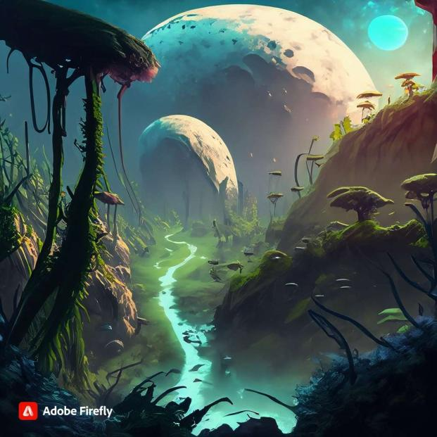
Myriabel’s Unique Characteristics
Unique Magnetic Field Interaction:
Geological Diversity
Gravitational Resonance Rings
Quantum-Resonant Crystals

Slide 9
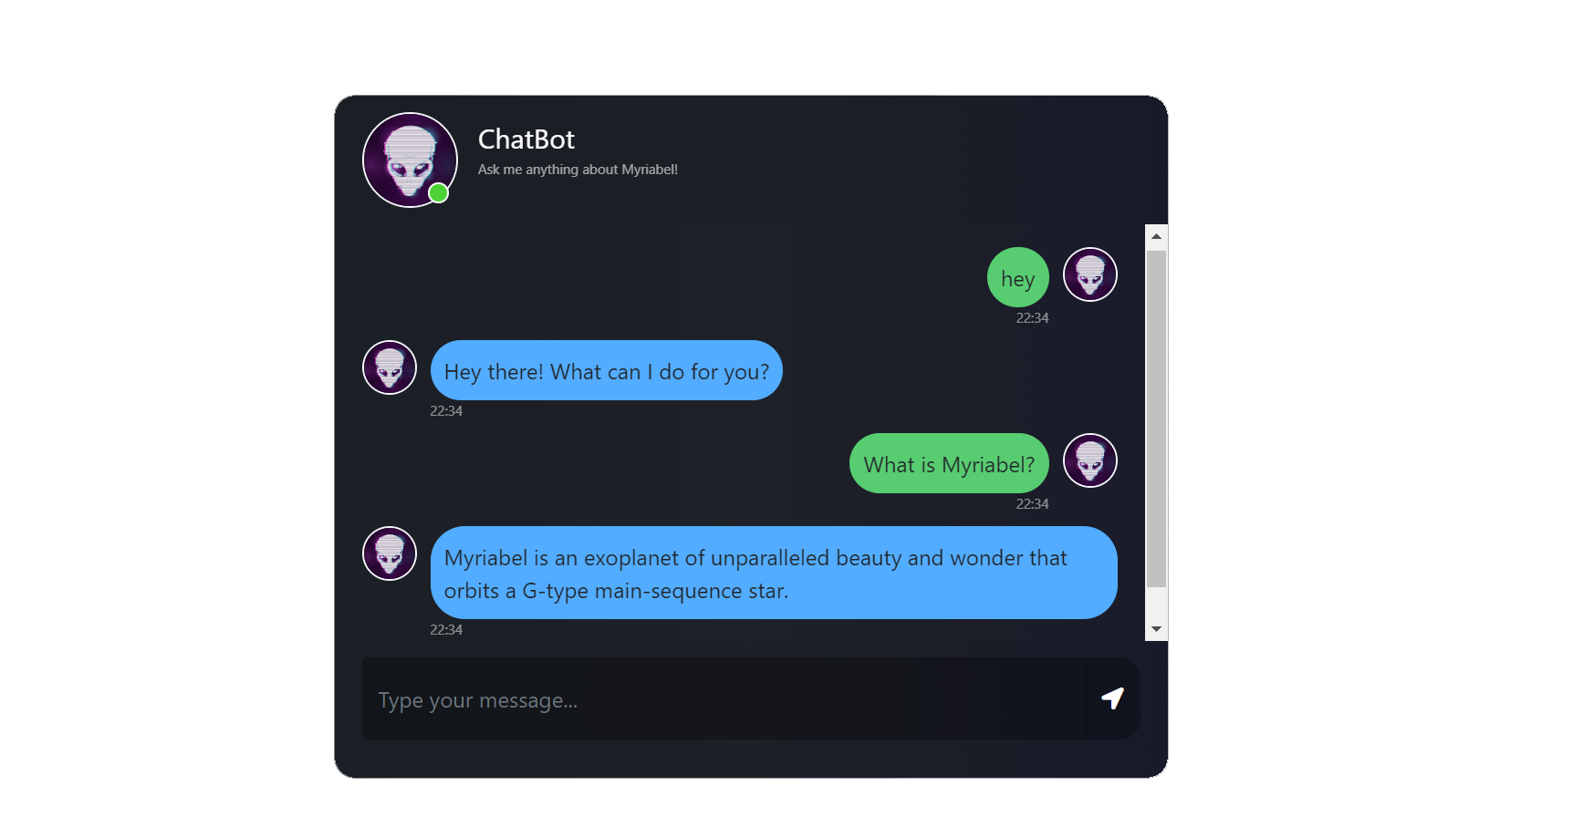
03
Myriabel.co ChatBot
Exploring Planetary Data with AI Chatbot Brilliance.

Slide 10
25%
50%
75%
100%
Frontend
Backend
Training
Production
We employed HTML and CSS.
We utilized Python with the Flask framework.
We employed Natural language processing to train our model using JSON datasets from various nasa resources.
To deploy our chatbot, we utilized NGINX and Gunicorn on an Ubuntu server hosted on Azure and a Domain name from Godaddy as provided by the nasa app challenge offers.

Slide 11
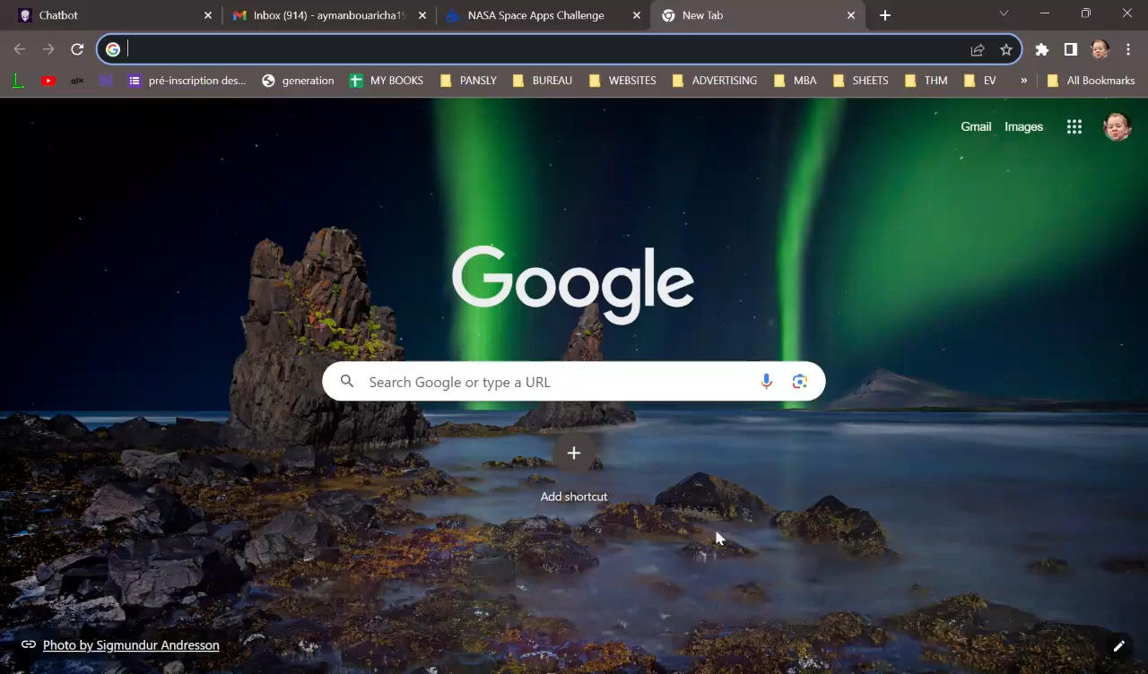
DEMO

Slide 12
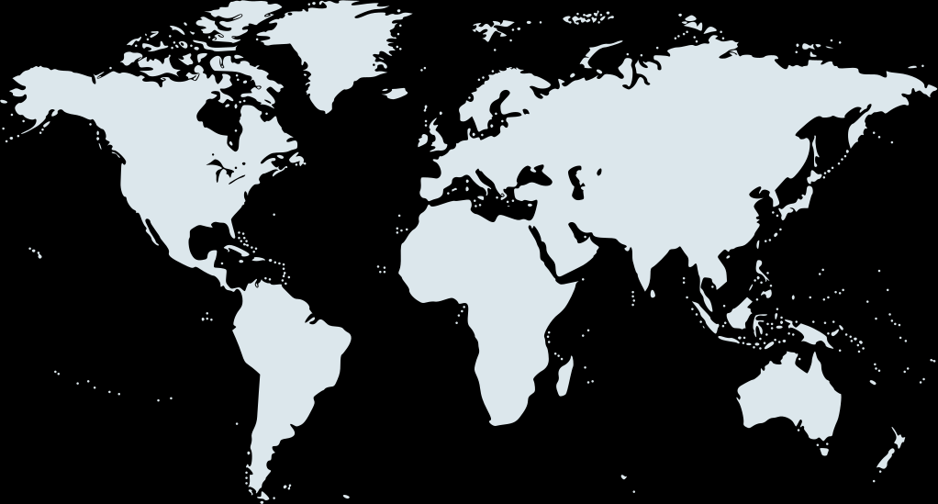
Targeted Audience
The Space industry
a niche but influential sector, requires a high-a and reliable product to support space exploration and satellite operations.
Youth
a vast and dynamic demographic, are interested in engaging, educational products that ignite heir curiosity about space and technology, making it accessible to a broad audience.
Researchers
a diverse community spanning various disciplines, seek a versatile solution to enhance their scientific investigations and data analysis across different research scales.

Slide 13
PRODUCT EVOLUTION
01
02
03
04
Phase 1
Phase 2
Phase 3
Phase 4
TESTING WITH OUR DATASASET
UPLOAD USER’S LIMITED SIZE DATASET
UPLOAD USER’S UNLIMITED SIZE DATASET
INCLUDE KIDS FRIENDLY PLATFORM FOR LEARNING

Slide 14
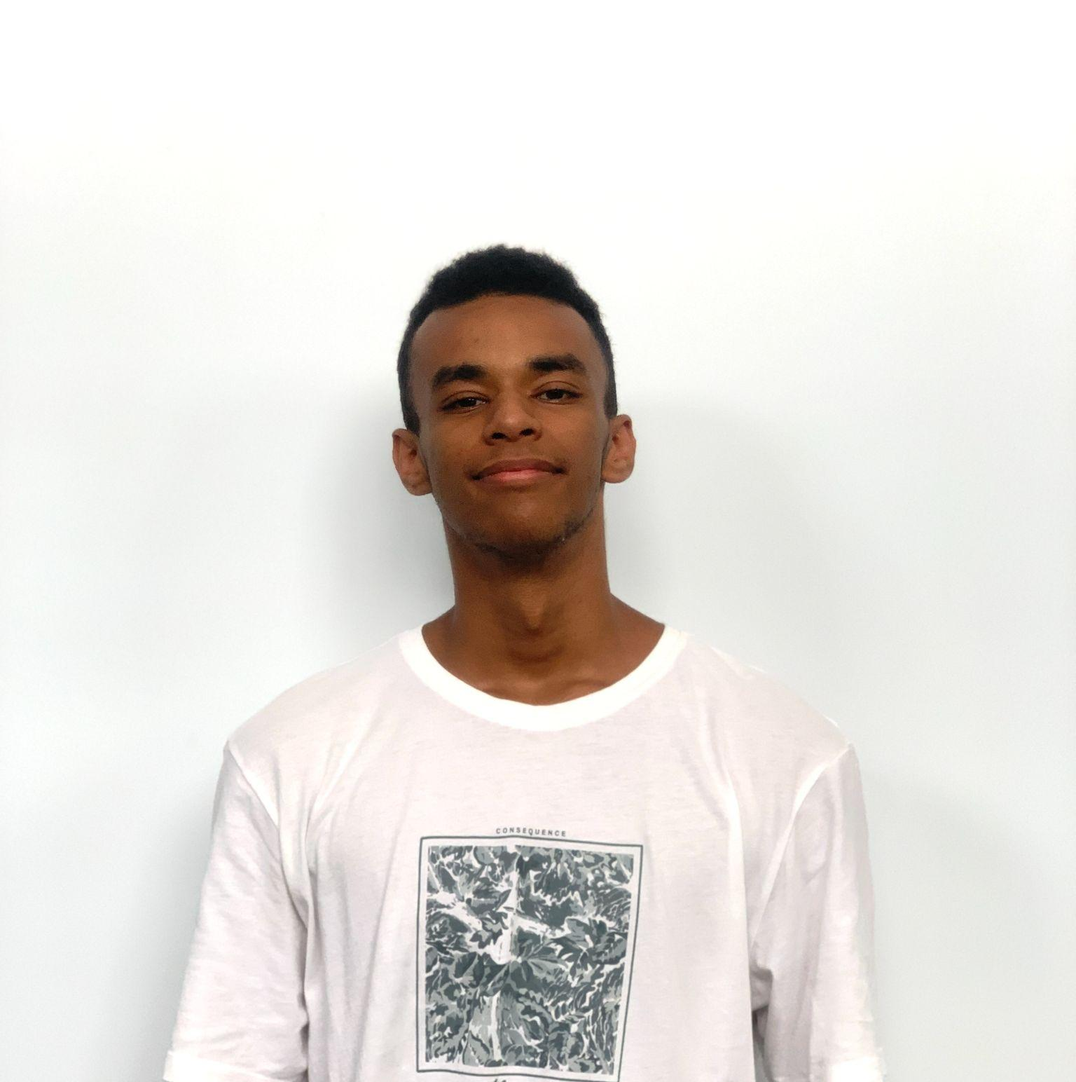

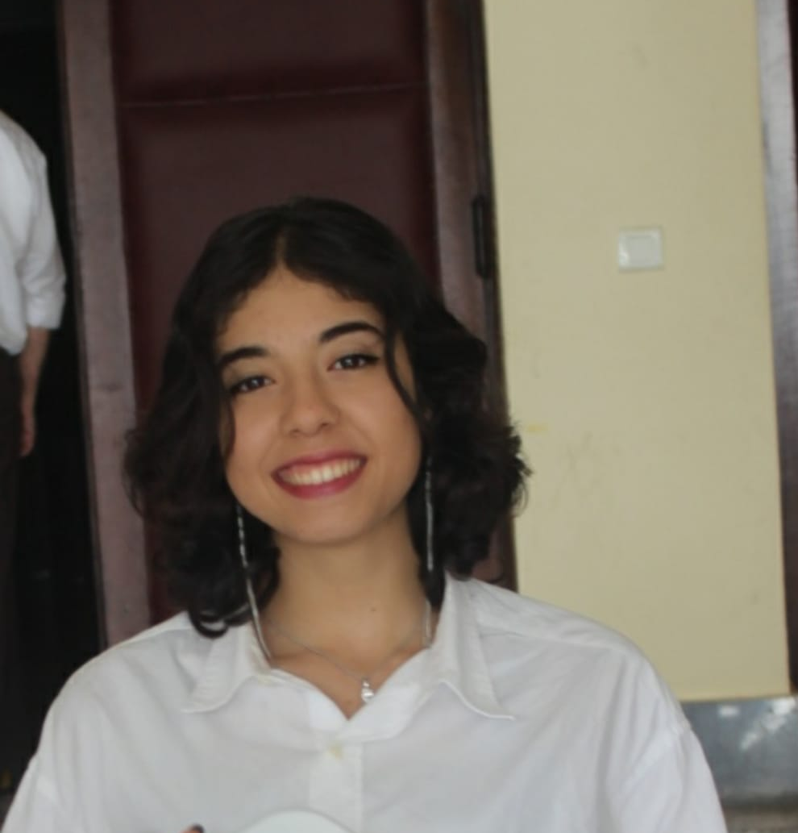
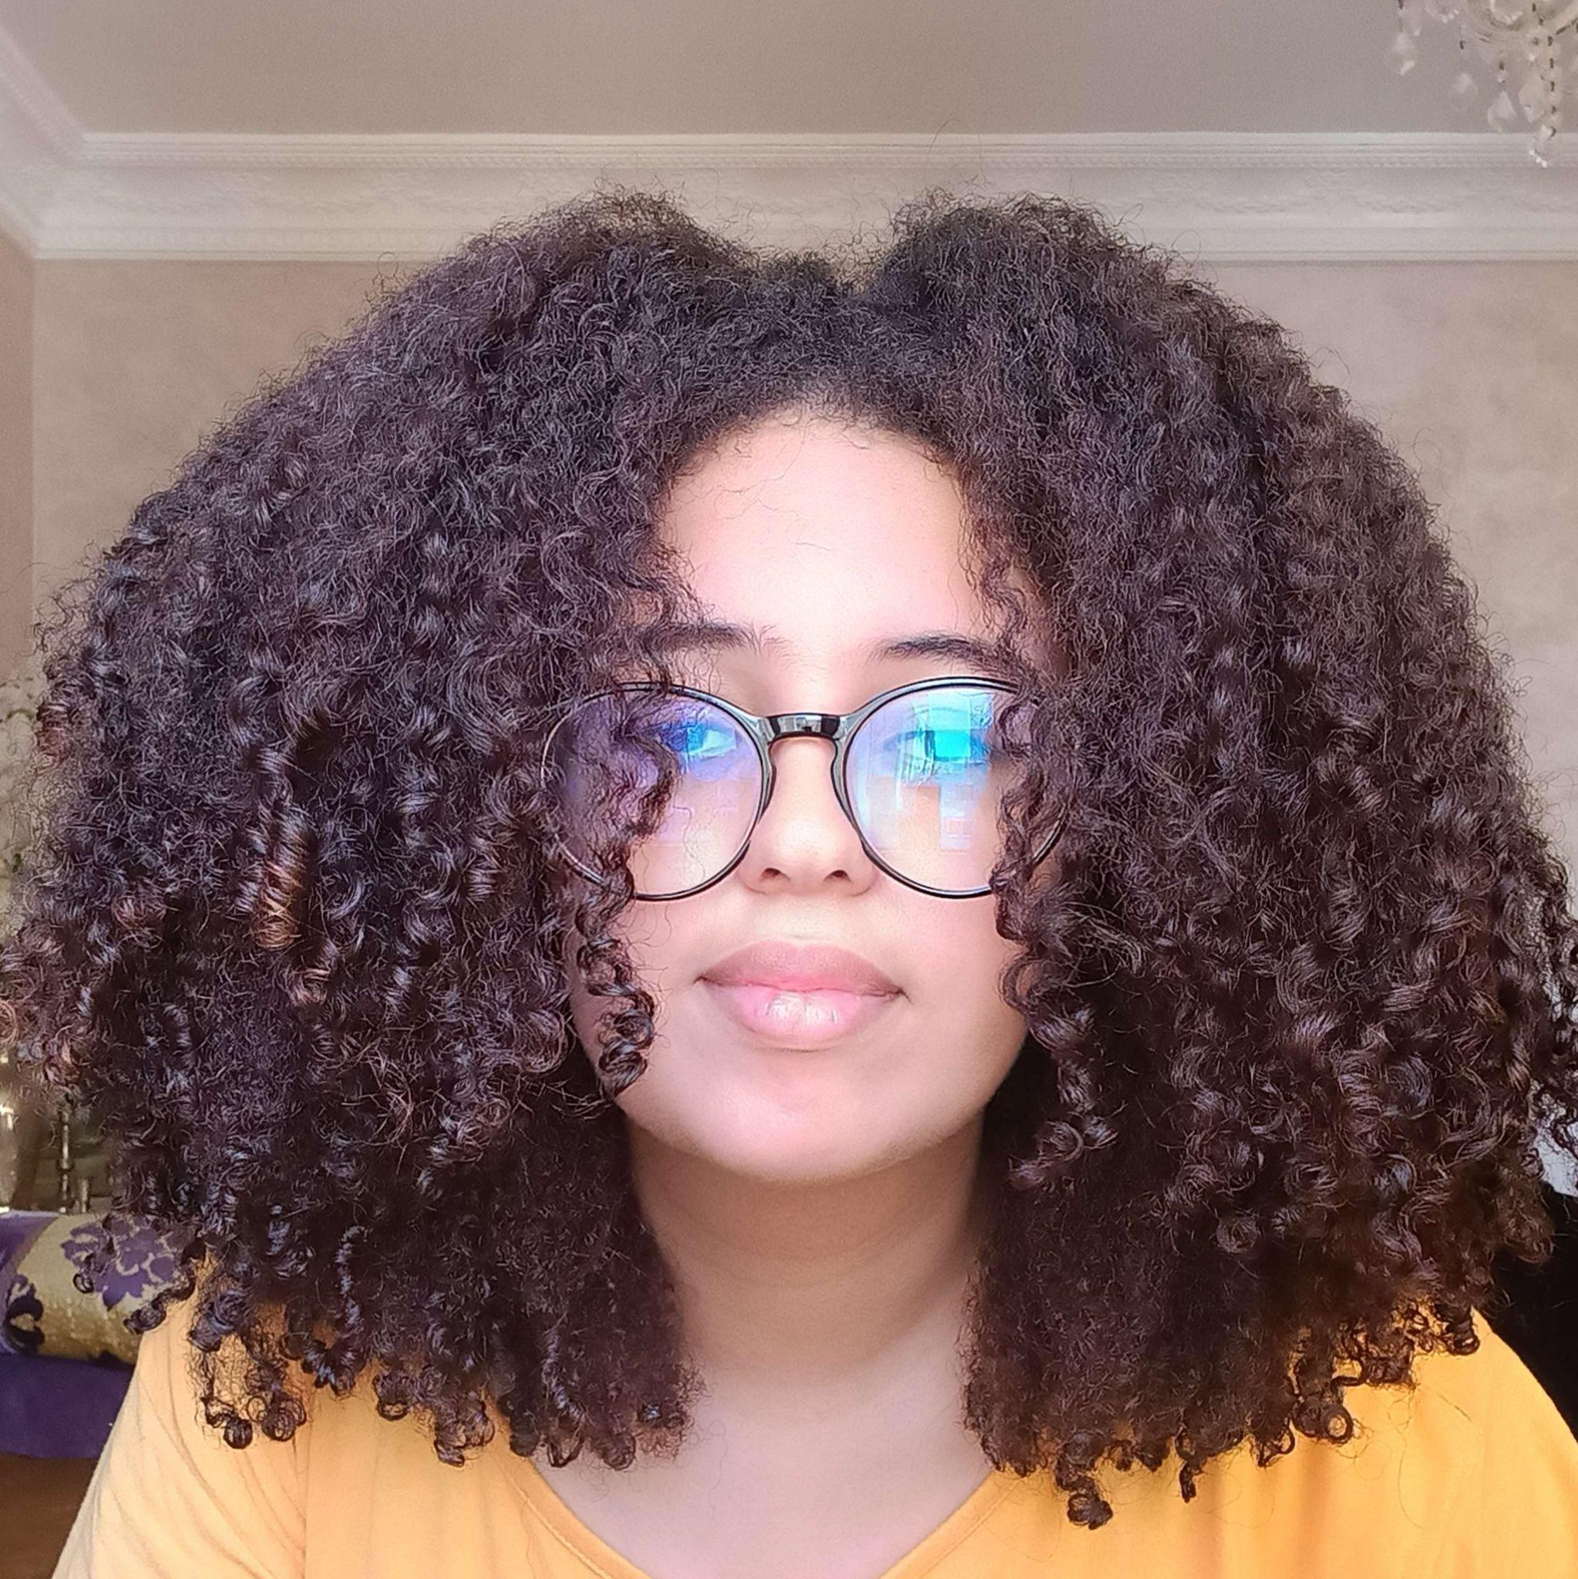
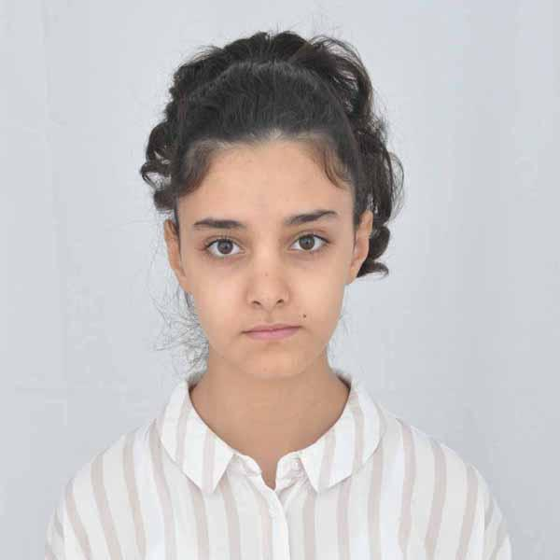
MEET THE DREAM TEAM!
AYMAN BOUARICHA
DevOps
YASSINE OUIALANE
AI Developer
NAWAL BELLAMECHE
Project manager
HIBA EL HJOUJI
Data analyst
DOUNIA YAKOUBI
Researcher

Slide 15

THANK YOU
spaceappschallenge.org

Slide 16
REFERENCES
https://exoplanets.nasa.gov/exoplanet-catalog/6992/16-cygni-b-b/
https://exoplanets.nasa.gov/search-for-life/are-we-alone/
https://exoplanets.nasa.gov/search-for-life/why-we-search/
https://exoplanets.nasa.gov/eyes-on-exoplanets/?destinations=/alien-worlds/strange-new-worlds/#/planet/KELT-9_b/
https://firefly.adobe.com/
https://www.forbes.com/sites/johnkoetsier/2021/05/22/space-inc-10000-companies-4t-value--and-52-american/?sh=480ece6755ac
https://www.thebrainyinsights.com/report/early-childhood-education-market-12703#:~:text=As%20per%20The%20Brainy%20Insights,USD%20676.7%20billion%20by%202030
https://www.globenewswire.com/en/news-release/2023/04/28/2657266/28124/en/Market-Research-Services-Global-Market-Report-2023-Sector-to-Reach-95-49-Billion-by-2027-at-a-3-3-CAGR.html#:~:text=The%20global%20market%20research%20services,(CAGR)%20of%203.4%25.
https://exoplanets.nasa.gov/what-is-an-exoplanet/in-depth/
https://exoplanets.nasa.gov/what-is-an-exoplanet/planet-types/overview/
https://exoplanets.nasa.gov/alien-worlds/historic-timeline/#first-planetary-disk-observed
https://www.asc-csa.gc.ca/eng/news/articles/2022/20220712-canada-s-niriss-reveals-steamy-atmosphere-distant-planet-in-detail.asp
https://www.esa.int/Science_Exploration/Space_Science/Exoplanets/What_are_exoplanets
https://www.esa.int/Science_Exploration/Space_Science/Exoplanets
https://www.esa.int/kids/en/Multimedia
https://www.esa.int/
https://www.esa.int/Science_Exploration/Space_Science/Webb/Science_with_Webb
https://www.esa.int/esearch?q=Exoplanets

